Slide 1
4 storytelling research PARADIGMS David M. Boje New Mexico State UnIversity
Slides & books to download at http://davidboje.com/Strathclyde/
Vita for books & articles http://davidboje.com/vita
TODAY’S WORKSHOP:
10AM-1PM Do 4 Storytelling Research Experiences
1PM-2PM LUNCH
2PM-4PM How to Analyze Storytelling Research
4PM-5PM How to Publish and not have Writer’s Block
Notes:
There are [European/American] Western Ways of Knowing (WWOK) with Dominant Narrative Paradigms
Indigenous Ways of Knowing (IWOK) with ‘Living Stories’ Paradigms
& Antenarrative Processes of Becoming beneath & between 1 &/or 2

Slide 2
4 Storytelling Paradigms 10AM – 1PM
Western Ways of Knowing (WWOK) Narrative Paradigm 1 → (Semi) Structured Interview Method
WWOK Narrative Paradigm 2 → Plot Types with Conversational Method
Indigenous Ways of Knowing (IWOK) Living Story Web Paradigm → Kaupapa Māori [Method + Theory in Praxis]
Antenarrative Process Paradigm using Karen Barad [‘agential realism’ = materiality with discourse] AND Boje’s Antenarrative process analytics on Etieno Enang’s M&A Study of Concrete Industry

Slide 3
Why Storytelling Matters
“To “tell a story is to act upon the world” (Cobb, 1993, p. 250) and as such, depending on how the stories are constructed (and analyzed), narratives can specify the “truth”, stipulate correct behavior, and legitimize how problems are defined (Whitten, 1993)” (Higgins, Stubbs, & Love, 2014: 1097).
Notes:
Cobb, S. (1993), “Empowerment and mediation: a narrative perspective”, Negotiation Journal, Vol. 9 (1): 245-259. Higgins, Colin; Stubbs, Wendy; Love, Tyron. (2014),"Walking the talk(s): Organizational narratives of integrated reporting", Accounting, Auditing & Accountability Journal, Vol. 27 (7): 1090 - 1119
Whitten, M. (1993), “Narrative and the culture of obedience at the workplace”, in Mumby, D. (Ed.), Narrative and Social Control: Critical Perspectives, Sage, Newbury Park, CA, pp. 97-118.

Slide 4
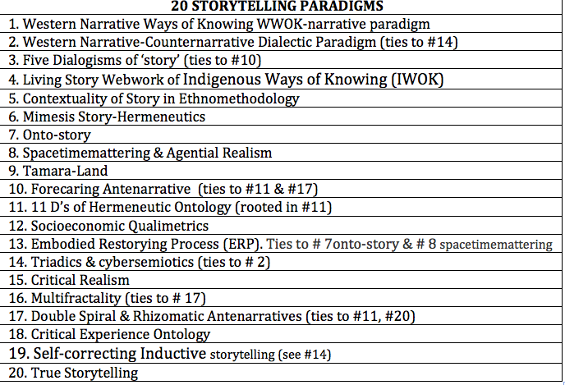
Which Paradigms Do you Know?

Slide 5
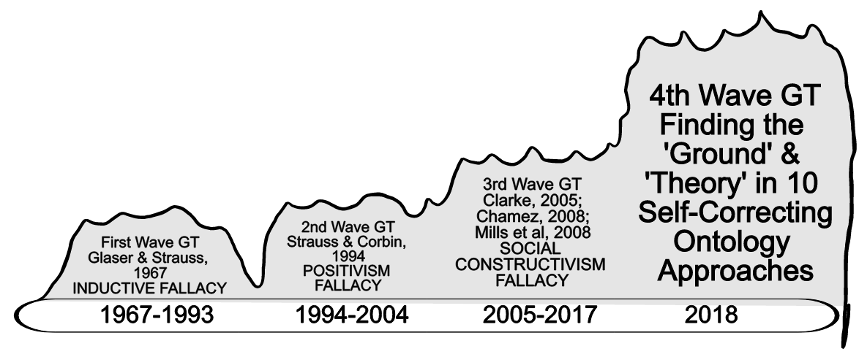
Pre-work: Which Storytelling Research Methods do you know and not know?
Please Review 20 Storytelling Paradigms; 18 are beyond 1st 3 waves of Grounded Theory (GT), and are basis of two new books on 4th Wave Self-Correctinog Grounded Ontologies to download at http://davidboje.com/Strathclyde/

Slide 6
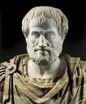
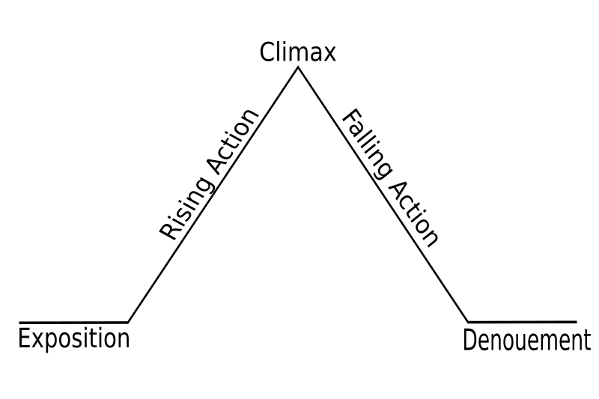
NARRATIVE IS BME
Narrative requires story to be “… a whole … a whole is that which has beginning, middle, and end” (Aristotle, 350 BCE: 1450b: 25, p. 233).
Notes:
See articles by Boje, Rosile and colleagues on Enron.

Slide 7
Example of Exercise 1 Questions
In ‘direct interviewing’ questioning, interviewers asked questions about supervision including:
How does your boss treat you?
Does your boss ever bawl you out?
Has he any favorites?
Is your boss a slave driver?
Do you consider your boss to be reasonable?
Questions about working conditions:
Is your job fatiguing or dirty?

Slide 8
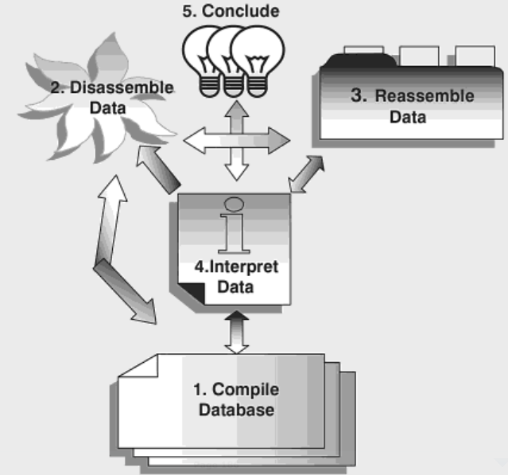
1st Exercise
Compile fieldnotes of narratives heard
Disassemble (breakdown) narrative into theme-fragments of each plot
Reassemble the fragments into typology of contrasts across fragments (called Domain Analysis in Spradley)
Interpret the typology into a ‘new’ BME-narrative you write up now as researcher
Conclude with conclusions from entire typology-narrative of your study, ‘grounded’ in ‘theory’ from published journals/books
Western Ways of Knowing (WWOK) Narrative Paradigm 1 → (Semi) Structured Interview Method
INSTRUCTIONS: Individually, pick research topic you are studying, write 5 (semi)-structured questions, then find partner and take turns interviewing each other while you make verbatim field notes & then do these 5 steps from Yin, R. K. (2015/2017: 186). Qualitative research from start to finish. Guilford Publications.

Slide 9
Debrief Semi-Structured Interviews
LIST ADVANTAGES
1.
2.
3.
LIST DISADVANTAGES
1.
2.
3.

Slide 10
Debrief Exercise 1
Direct Semi-Structured Approach: The interviewer had to keep interrupting the accounts and stories, in order to, get the participant back on topic
Hawthorne Studies initiated when in July of 1929, after 1600 interviews, they halted the project, and changed their interviewing method from semi-structured and structured interviews they called the ‘direct approach to questioning’ to the ‘indirect approach’ in which people told their accounts and stories, without interruption, without trying to herd the interviewee back so some a priori topics and sub-topics (Roethlisberger, Dickson, & Wright: 1939: 203)
By October 1929, a second change in interviewing was initiated. Instead of taking notes on the positive or negative statements made regarding the a priori topics of supervision, working conditions, and company (and their sub-themes), the interviewer made verbatim notes on all topics that the participant brought up, using what we now call, ‘’non-specific questioning’ technique (see work by Henri Savall in the Socioeconomic interviewing chapter summarized

Slide 11
Conversational Ground Rules
The interviewer should listen not only to what a person wants to say but also for what he does not want to say or cannot say without help.
The interviewer should treat the mental contexts described in the preceding rule as indices and seek through them the personal reference that is being revealed
From these new interviewing methods it was concluded that the ideology expressed by workers was “not based upon a logical appraisal of their situation and that they were not acting strictly in accordance with their economic interests” (Roethlisberger, Dickson, & Wright: 1939: 534).

Slide 12
WEICK - SENSEMAKING
WWOK Narrative Paradigm 2 → Plot Types with Conversational Method
“typically searching for a causal chain”, “the plot follows - either the sequence beginning-middle-end or the sequence situation-transformation-situation. But sequence is the source of sense” (Weick, 1995: 128)
Notes:
Polkinghorne (1988: 15) follows the structural functionalist approach of treating “narrative as a cognitive scheme.”

Slide 13
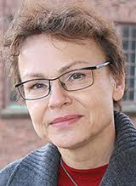
ORGANIZATION STUDIES IN ARISTOTLE TRADITION
WWOK Narrative Paradigm 2 → Plot Types with Conversational Method
Czarniawska (1997: 78), for example, says narrative, or “a story consists of a plot comprising causally related episodes that culminate in a solution to a problem.” Elsewhere, Czarniawska (1999: 2) clarifies, “for them to become a narrative, they require a plot, that is, some way to bring them into a meaningful whole.”
Applying Barthes petrification of narrative thesis, where “… every narrative becomes new with each retelling, and the ‘petrification’ of stories is not the result of the myopia of the researcher but of intense stabilizing work by the narrators” in organizations” (2004: 38)
Notes:
Czarniawska, Barbara (1997a.) A Narrative Approach to Organization Studies, London: Sage
Czarniawska, Barbara (1997b.) Narrating the Organization: Dramas of Institutional Identity, Chicago: University of Chicago Press
Czarniawska, B. (1999) Writing Organization, Oxford: Oxford University Press
Czarniawska, B. (2004) Narratives in Social Science Research, London: Sage

Slide 14
YIANNIS GABRIEL
WWOK Narrative Paradigm 2 → Plot Types with Conversational Method
“Stories are narratives with plots and characters, generating emotion in narrator and audience, through a poetic elaboration of symbolic material” (italics in original)
“I shall argue not all narratives are stories; in particular, factual or descriptive accounts of events that aspire at objectivity rather than emotional effect must not be treated as stories” (2000: 5).
“However, the mythologized past that is celebrated in organizational nostalgia is 'generally idealized' and bears little relation to 'documented history' (Gabriel, 2000: 170-177)”, as cited in Clark & Rowlinson 2002: 11.
Notes:
“Boje's tersely told “you know the story” is a “narrative
deskilling,” not a “proper” story, with plot, preventing full collections being built in
management, as they are in his version of “organization folklore” (19-21)
Gabriel, Y. (2000) Storytelling in Organisations, Oxford: Oxford University Press
Gabriel, Y. (ed.) (2004) Myths, Stories, and Organizations: Premodern Narratives for Our Times, Oxford: Oxford University Press
Rowlinson et al “Business historians (e.g. Dellheim, 1986: 20; Kantrow et al., 1986) claim that many organizations would welcome an opportunity to confront their myths in the context of their history, to question whether their self-perception is accurate or distorted, creative or destructive, or whether their corporate "traditions" are selective misreadings of the past designed for legitimation. “

Slide 15
WWOK Narrative Paradigm 2 → Plot Types with Conversational Method
Aristotle, Weick, Czarniawska, & Gabriel say narratives have plots:
Count off by 4’s
Individually, write brief notes on a plot of your life that is your narrative number: 1. Tragedy, 2. Comedy, 3. Romance-Adventure, & 4. Irony.
Pick a new plot (another of the 4 types), and re-narrate same events & characters into a new narrative-plot. Write down a few notes, and put your notes away.
Find a partner and do CONVERSATIONAL INTERVIEWING with each other. In CONVERSATIONAL INTERVIEWING there is mutual sharing back and forth rather than one way interrogation.

Slide 16
Debrief Conversational Interviewing
LIST ADVANTAGES
1.
2.
3.
4.
LIST DISADVANTAGES
1.
2.
3.
4.

Slide 17
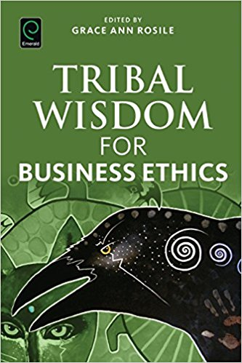
IWOK – Indigenous Ways of Knowing in Living Story Webs of Relations to Family, Community, & Earth
Relationships are the end in themselves
Gifting is valued more highly
Egalitarianism is preferred
Non-acquisitiveness valued, not greed
Usefulness or access to use is valued
Barter is what is needed
Trust and buyer trust valued
Disclosure is full and voluntary

Slide 18
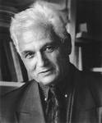
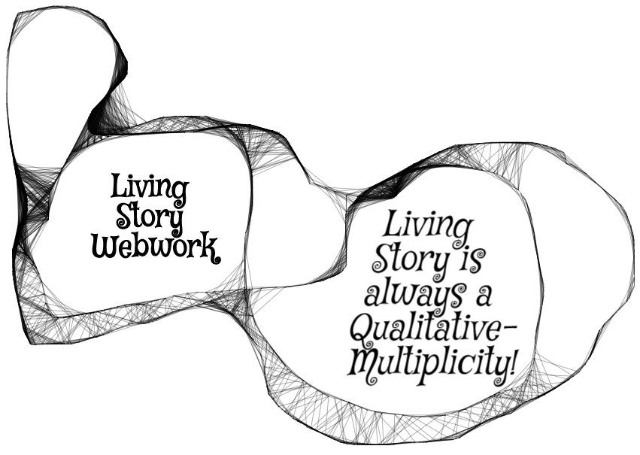
Living Story is Reflexivity Webwork
Indigenous Ways of Knowing (IWOK) Living Story Web Paradigm → Kaupapa Māori [Method + Theory in Praxis]
“Each story is at once larger and smaller than itself, includes itself without including (or comprehending) itself, identifies with itself even as it remains utterly different…” (1979: 82).; Derrida , treats story more in terms of their reflexivity web of story to other stories (99-100).
Notes:
Derrida (1979: 99-100), for example, treats story more in terms of their reflexivity web of story to other stories.

Slide 19
LIVING STORY IS MULTIPLICITY OF VOICES
Indigenous Ways of Knowing (IWOK) Living Story Web Paradigm → Kaupapa Māori [Method + Theory in Praxis]
Dialogical manner of story is “The plurality of independent and unmerged voices and consciousness and the genuine polyphony of full-valued voices” (Bakhtin, 1973: 4).
Story and narrative are different: “Dialogic manner of the story” (1981: 60); “Narrative genres are always enclosed in a solid an unshakable monological framework” (1973: 13); In dialogism there is a move beyond “systematic monological philosophical finalizedness”

Slide 20
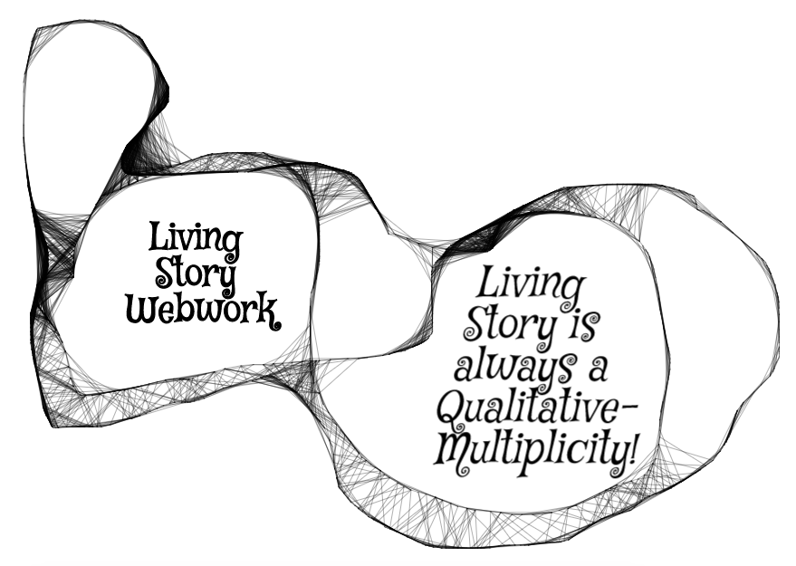
Qualitative-Multiplicity of our Living Stories
Living Story is unfolding present, in a web of answerable spheres of relationship: family, work, community, friendship, education, & ecology without beginning or end, just in the middle (Boje, 2008, 2014, 2016)

Slide 21
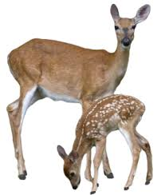
Living Story Example before you begin
“Grandpa John told me endless stories about young men who had opportunities to live up to their names. One day, he said, ‘there was a young man named Looks Twice---really, he was more like a boy---who left his village alone to hunt, hoping to bring back some meat. He wanted to prove that he was a man. It was in the springtime. He went without a bow or a lance, and he killed a deer with his knife.’… ‘How did he kill the deer, Grandpa?’ I interrupted. ‘You’d better figure that out,’ he said. ‘That’s what will make you a man.’” (Russell Means, in Fixico, p. 88, as cited in Rosile, 2016: 239).

Slide 22
What was he supposed to be looking at?
CONTEXT: What does ‘runs like a deer’ mean?
1. How could LOOKS TWICE get close enough to kill a deer, if he is alone?
2. What kind of deer would be that slow?
3. In Spring, the rains flood the streams?
4. If one hunts with others, then there are more pairs of eyes to see
5. When something seems too good to be true…
6. If true, then is this INDIVIDUALISM the ways of TRIBAL COMMUNITY?
7. What are the sustainability long-term effects of this kind of hunting?
8. Many reasons why hunting alone is TABOO, a rule this young hunter broke
9. When growing up others hear this story and by the time they are young adult, they know the CONTEXT of the living story lessons

Slide 23
Indigenous Ways of Knowing (IWOK) Living Story Web Paradigm → Kaupapa Māori [Method + Theory in Praxis]
TwoTrees 1997 & 2000; Durie 2011; Rosile 2016, Pepion 2016; Cajete, 2000, 2008, & 2016; Grayshield 2016; Humphries, 2016; L.T. Smith 1999, 2008; G.H. Smith 2003; Tyler, 2011; Deloria & Wildcat 2001; Hoskins & Jones, 2017’ Paulo Friere's Pedagogy of the Oppressed
Living stories have place, time, and ‘mind’ of aliveness; Living story is never alone, is always in the middle without beginning or end; and always points to another and yet another living story in the webwork of relationality of IWOK

Slide 24
EXERCISE 3: Indigenous Ways of Knowing (IWOK) Living Story Web Paradigm → Kaupapa Māori [Method + Theory in Praxis]
INSTRUCTIONS:
Write living story notes of your life in family, in relation to community, and if possible your connections to place, or moving from place to place
Pick is small problem or obstacle in that family/community and make notes on transformative PRAXIS that you could do within your family/community/ecology
Pair off and and share your living story TERSELY, what they other would know if they had been there, in the know about CONTEXT, SITUATION. See how your partner is able to ask you about the CONTEXT, and comes to UNDSTAND YOUR GROUND and your Story-Theory, and your PRAXIS. Be sure to follow the 5 I’s from Rosile (2016:96-7)→
Kaupapa Māori, Friere's Pedagogy of the oppressed, and some Participative Action Research (PAR) put storytelling method/theory into PRAXIS of liberation from oppressions
PRAXIS means THEORY+METHOD in ACTION, a transformational change/liberation from oppression, injustice, in order for family and/or community to bring about new way of Being-in-the-world together so LOOKS TWICE has lessons for the Elders and Parents to teach the young, growing up, so they don’t hunt alone, and destroy the herd the sustains the tribe.
1.INDIRECT Give a ‘story-stem’ and ask partner to complete the story, what do you imagine happened next?
2. INCLUSIVE – Include non-human characters in your story They send meta message about Natural world
3. INCOMPLE – Tell it terse so the partner fills in the blanks with taken-for-granted assumptions
4. IN CONTEXT – Partner needs to explore the context of the story to discover learning principles/lessons
5. INQUIRING – Story-teller, ask partner ‘what is the moral of this story’ rather than just telling it.
Notes:
1.INDIRECT Give a ‘story-stem’ and ask partner to complete the story, what do you imagine happened next?
2. INCLUSIVE – Include non-human characters in your story They send meta message about Natural world
3. INCOMPLE – Tell it terse so the partner fills in the blanks with taken-for-granted assumptions
4. IN CONTEXT – Partner needs to explore the context of the story to discover learning principles/lessons
5. INQUIRING – Story-teller, ask partner ‘what is the moral of this story’ rather than just telling it.

Slide 25
Debrief Living Story Conversations
LIST ADVANTAGES
1.
2.
3.
4.
LIST DISADVANTAGES
1.
2.
3.
4.

Slide 26
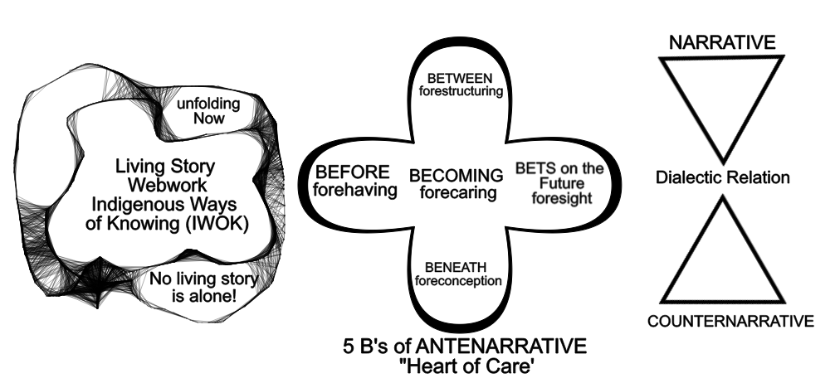
Antenarrative Process Paradigm is Betwixt & Between IWOK Living Story Webs & WWOK Dominant Narrative-Counternarrative

Slide 27
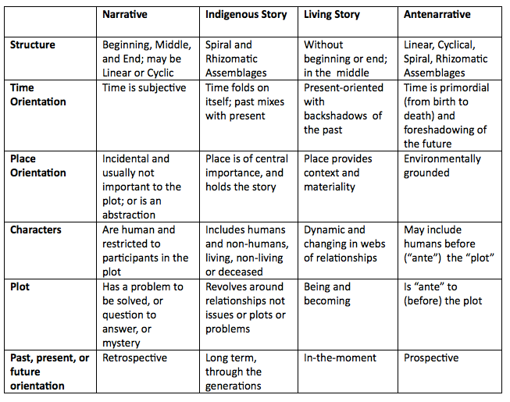

Slide 28
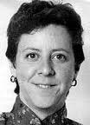
Narrative-Discourse turn went too far
“Language has been granted too much power. The linguistic turn, the semiotic turn, the interpretative turn, the cultural turn: it seems that at every turn lately every “thing”—even materiality—is turned into a matter of language or some other form of cultural representation” (Karen Barad, 2003: 801).
Notes:
“There is more to agency than the possibilities of linguistic resignification, and the circumvention of deterministic outcome does not require a clash of apparatuses/discursive demands (i.e., overdetermination)” Barad, 2003: 826 footnote).
Barad, K. (2003). Posthumanist Performativity: Toward an Understanding of How Matter Comes to Matter. Signs: Journal of Women in Culture and Society 2003, vol. 28, no. 3: pp. 801-831. Available on line at http://www.kiraoreilly.com/blog/wp-content/uploads/2009/06/signsbarad.pdf

Slide 29
Barad Quick Overview
Barad uses a posthumanist storytelling of discursive practices, materiality, and the relationship between them, rather than just humanist accounts.
Storytelling is agentive realism, when it is the intra-activity of materiality with discourse. It is never interaction, always intra-activity.
Concept of “ethico-onto-epistemological matter” (Barad, 2008: 333),in inseparability of knowing-being-doing entanglements
Like Barbara Simpson, Barad treat duality as a both/and ontology and dualism as an either/or epistemology.
There are agential cuts in doing a method, telling a narrative or story, that create self and other.
An apparatus (such as research method) makes agential cuts
Its never space, time, matter, but rather inseparability entanglement of spacetimemattering in iterative reconfiguring.
Notes:
Barad, K. (2008). Queer causation and the ethics of mattering. Queering the non/human, 311-338 in Noreen Giffney and Myra J. Hird (Eds.) Queering the Non/Human. Hampshire, England/Burlington VT: Ashgate Publishing.

Slide 30
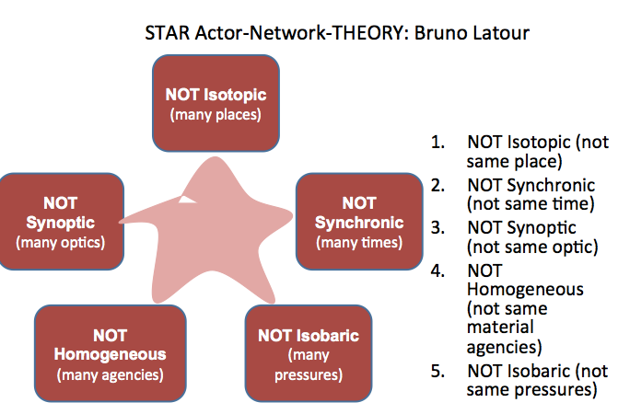
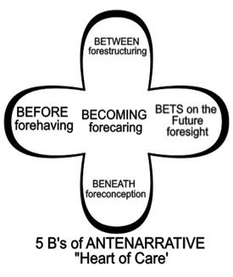
Antenarrative Process Paradigm using Karen Barad [‘agential realism’ = materiality with discourse] AND Boje’s Antenarrative process analytics on Etieno Enang’s M&A Study of Concrete Industry
What is Actor Network Theory (ANT)?
What is Agential Realism in Karen Barad’s work
What is Sociomaterialism?

Slide 31
ANTENARRATIVE FRAMEWORK OF M&A STORYTELLING
Etieno Enang’s M&A Study of Concrete Industry
Between
(sense-making: narratives which highlight learning in the here and now, narratives which reveal the ’mood’ of practitioners
Beneath
(interpretation, matching, linking; storying,restorying of the past and future)
Bet
(linear time, narratives of the future driven by prior understanding: future perfect thinking)
Becoming
Reification of plausible narratives
Before
(linear time, narratives of past understandings
Agency as flow: assemblages of time, space, materiality

Slide 32
The affordances of cement (matter)
For us it is very important that the cement assets that we are purchasing/ acquiring for instance the quarries that serve the plant have enough reserve to justify the investment. “ (Participant 4, third conversation)
cement is a heavy product which will cost so much to export therefore every region has to have its own plants, because of that we had to empower managers as decisions need to be made locally and not globally. (participant 1, second conversation
Etieno Enang’s M&A Study of Concrete Industry

Slide 33
The spaces of the present and past
Because nowadays, Brazil is going down the drain; we are relying on North American, Europe, Africa and Asia clusters to mitigate the loses or the downturn in Brazil. At the time of the acquisition, there was no inclination that Brazil would go through this downturn. At the time, they were still approving investments to have more capacity; to install more capacity into the market. (participant 1, third conversation)
Etieno Enang’s M&A Study of Concrete Industry

Slide 34
Agency of spaces..
you do a business plan based on assumptions, and if in the first years that you are doing the integration, your business fails because of the macroeconomic environment; it also can affect the success of the integration because you have to change completely your integration process.. So that happened in Canada and united states when we had a business plan for the acquisition and then due to the market drop, we had to change a lot, we had to close plans, we had to fire people, we had to change the approach in the market, we had to change the promises and it was very difficult then to have the commitment of the local team. (participant 2, sixth conversation)
Etieno Enang’s M&A Study of Concrete Industry

Slide 35
Then and now
“…But when we first came, we said ‘no, we are not going to change people’, because we are not going to know how to run the business being that we were a Brazilian firm with very little experience…” (1st conversation with Participant 3)
learning the language, learning the culture- I think we as a company said enough is enough, respect is respect; now let’s really make the change. And then we changed some key members; for example, at that time, the HR person we let her go, the president of the company we let him go...” [...] “...I think we have that clear head that there is no person working for any company that cannot be changed (participant 4, 3rd conversation)
Etieno Enang’s M&A Study of Concrete Industry

Slide 36
Multiple perspectives
the companies today are becoming too financial driven. I think there is much more intangible advantage that we cannot measure, which is the learning, the getting people spreading out all over the other countries, the knowledge of different people sharing what they do good and you copying and implementing in other countries, respect with cultures. (first conversation with participant 3)
Then we say but ‘if we put our foot print out there, we are going to get better rates, and we are going to get engaged with banks in US, Canada, Spain and everywhere, our interest rate is going to be lower compared to other companies still here in Brazil (participant 4)
we were not successful in this integration, in this acquisition. I mean we paid a lot of money and we did not get much out of it. (participant 1)
Etieno Enang’s M&A Study of Concrete Industry

Slide 37
Agency of the leaders
Yes, well look at my case here. When I came to work here in North America; the division I work right now was not the most important division within our business. But in one year, right now officially 13 months, I made this division a hundred percent more visible within the organization than it was before. Now the company is now excited to invest more in my division than a year before. And then you ask yourself, okay is this division better now than it was before? No! Well it is in some ways better but slightly not like crazy a hundred percent better. So now, what made the company say: wow, now your division is now one of the top priorities to make investments within the organization? It’s not because the division is better, it is because I sold the division; better than it has ever been sold before! (participant 3, seventh conversation)
Etieno Enang’s M&A Study of Concrete Industry

Slide 38
EXERCISE 4: Antenarrative Process Paradigm using Karen Barad [‘agential realism’ = materiality with discourse] AND Boje’s Antenarrative process analytics on Etieno Enang’s M&A Study of Concrete Industry
Apply Etieno Enang’s storytelling of M&A process in the Concrete Industry
To Boje Antenarrative Process Analytic Methodology
INSTRUCTIONS: In small groups work through the 5 B’s, put them on a flip chart page
How is company preparing in advance BEFORE the M&A takes place?
What is in advance BENEATH the M&A in fore-conceptions?
Identify any BETWEEN the M&A parties, in their fore-structuring?
What are the BETS on the future made with foresight?
What is the entire BECOMING, forecaring of this M&A?

Slide 39
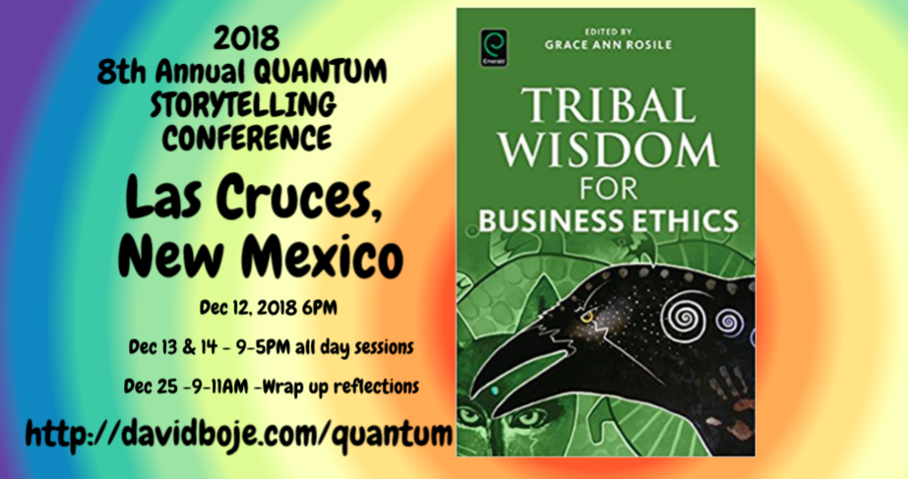
Q & A
Slides & books to download at http://davidboje.com/Strathclyde/

